Slide 1

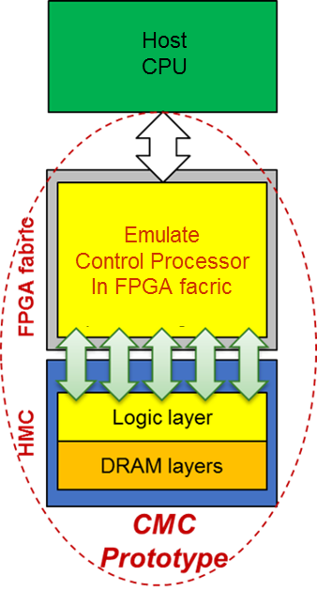
P3: Custom Memory Cube (CMC)
F3
Goal
Create flexible research platform for design space exploration of CMC apps & arch before existence of CMC
Motivation
Memory-intensive Big Data apps: memory bottleneck & high energy consumption
HMC: higher B/W & lower power than conventional memories
Potential for C-RAM* & PIM** processing (CMC)
Approach
Explore performance measurement methods for CMC platform
Research performance modelling for notional CMC architecture
Initial case study CMC app: DRE*** of LLNL
*C-RAM: Computational RAM
**PIM: Processor In Memory
⁺DRE: Data Reordering/Rearrangement Engine
From LLNL (Lawrence Livermore National Lab)

Slide 2
P3: Custom Memory Cube (CMC)
F3
Initial prototype of CMC research platform on Convey Merlin* board (FPGA + HMC)
Achievement
Model of notional CMC
Explore perf. measurement methods for CMC platform
Add hardware monitors to infrastructure Verilog code to count latency
Research perf. modelling for notional CMC architecture
Merlin board
*Merlin board from Convey Computer, Inc. (now part of Micron)
Nair, R., et al. "Active Memory Cube: A processing-in-memory architecture for exascale systems.“
IBM Journal of Research and Development 59.2/3 (2015): 17-1.

Slide 3

P3: Custom Memory Cube (CMC)
F3
$latency A=delay B+latency C$
$$\text{delay} \text{B}\text{: }\text{delay} \text{of} \text{transferring} \text{result} \text{data} \text{to} \text{host}\text{ (}\text{e}\text{.}\text{g}\text{. }\text{from} \text{VB} \text{to} \text{host} \text{in} \text{DRE}\text{)}$$
$latency C=latency C^{′}−delay D^{′}minusE^{′}+delay TSV$*
$$delay D^{′}minusE^{′}=latency D^{′}−latency E^{′}$$
$latency E^{′}=latency M_{5}−$ delay TX**
*delay TSV = time to transfer a request + time to transfer the response of that request = formula
**delay TX = time to transfer a request to HMC switch logic + time to transfer response back = formula
link: HMC external link (i.e., Link#0 or Link#1); #bit(RSP+REQ): bit width of transferred data
*Merlin board from Convey Computer, Inc. (now part of Micron)
Nair, R., et al. "Active Memory Cube: A processing-in-memory architecture for exascale systems.“
IBM Journal of Research and Development 59.2/3 (2015): 17-1.

Slide 4
P3: Custom Memory Cube (CMC)
F3
Perf. modelling of notional CMC architecture
Case study: Data Reordering/Rearrangement Engine
Achievements
Placeholder 1
Placeholder 2
Placeholder 3
Performance of single memory operations (wr/rd)
Performance of DRE operations
Performance of DRE applications: SpMV

